Slide 1
The World and Africa
By W. E. B. DuBois
Notes by Dr. Cynthia Lucas Hewitt

Slide 2
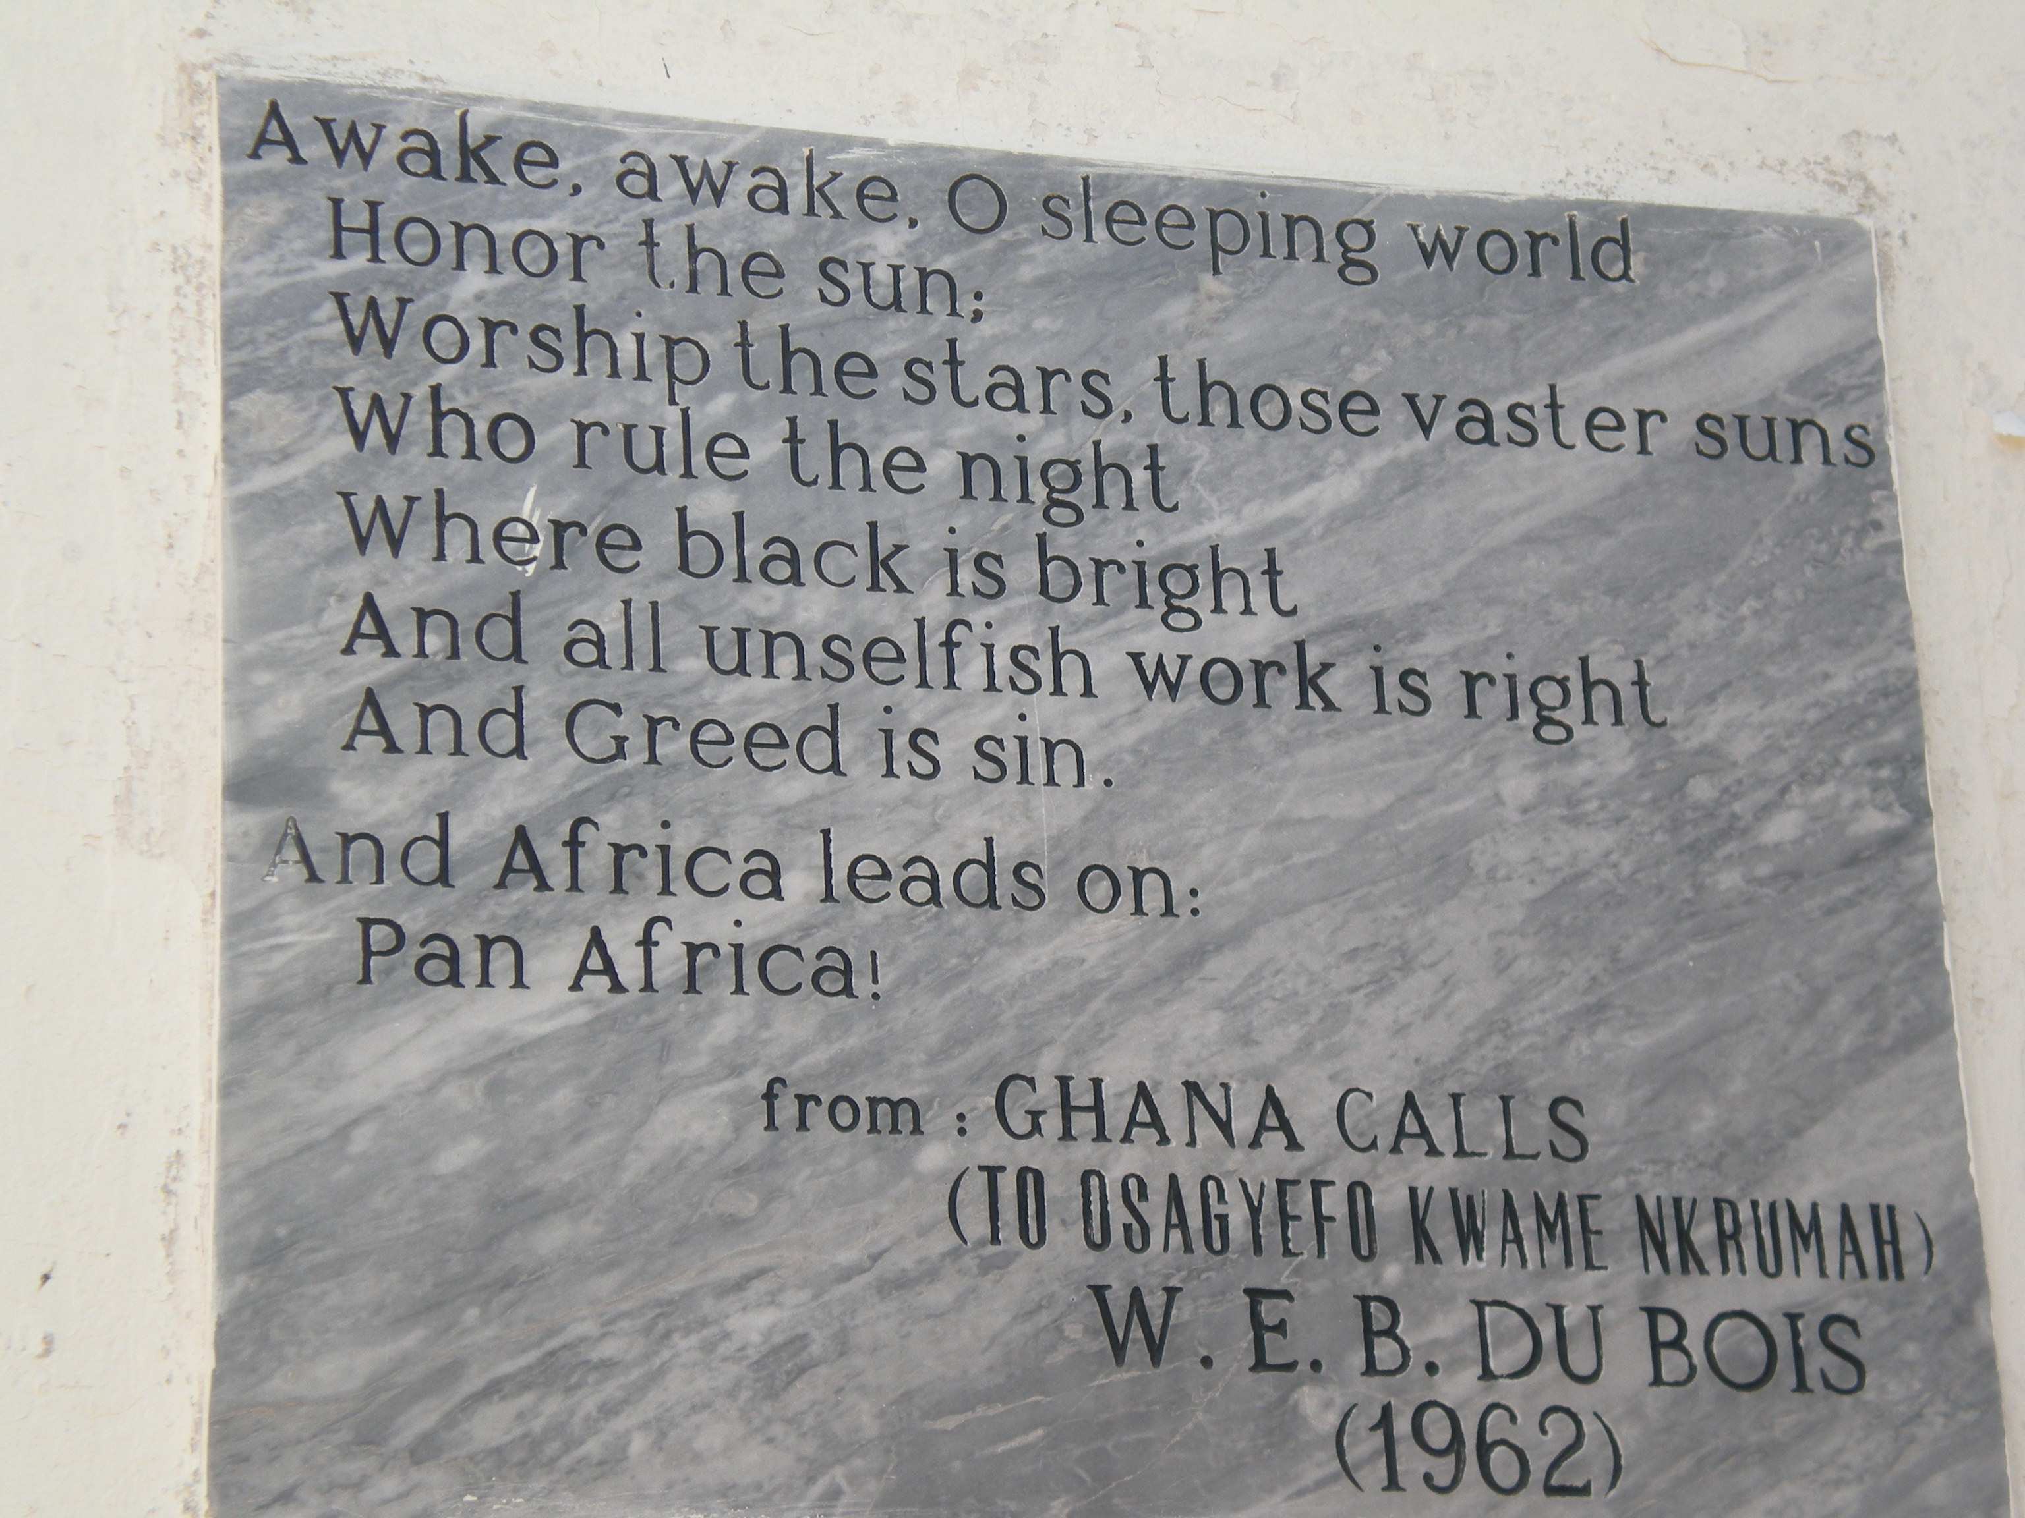
Plaque at the W.E.B. DuBois House in Accra, GHANA

Slide 3
In the “War of Position”…
There are setbacks but we are winning
Keep in mind that DuBois’ life, like any other, and perhaps more than most, was a journey. And it is a journey both ideologically and physically. It is the ideological journey with which we are most interested because the lessons learned by DuBois are lessons not just learned by DuBois but absorbed into the consciousness of the African Freedom Movement to guide us today.

Slide 4
DuBois three main themes:
The degradation of labor under capitalism is the true effective source of mistreatment of human beings, African people included. It is a divergence from the path of human history beginning in Africa.
The wealth and empowerment of the “White” world is the dialectical result of the capitalist exploitation and oppression of, and theft from, the Black world.
This exploitation and oppression is buttressed by an ideology of white dominance based on propaganda and lies told about Africans’ place within the world and world history. African liberation brings world truth.

Slide 5
…and One Main Answer:
Pan-Africanism
The Pan-African Congress came about from… “The idea of one Africa to unite the thought and ideals of all native peoples of the dark continent belongs to the twentieth century and stems naturally from the West Indies and the United States. Here various groups of Africans, quite separate in origin, became so united in experience and so exposed to the impact of new cultures that they began to think of Africa as one idea and one land.” p.6. In 1900 a first Pan-African Conference was called together by Sylvester Williams, of Trinidad.

Slide 6
Chapter 1: The Collapse of Europe
“I believe that the habit, long fostered, of forgetting and detracting from the thought and acts of the people of Africa, is not only a direct cause of our present plight, but will continue to cause trouble until we face the facts.” p.2

Slide 7
DuBois’ 3 Main Themes
Summarized:
Degradation of labor is a capitalist social force, among the most powerful.
A dialectical understanding of global social systems is required.
We must understand and expose capitalist and racist ideologies.

Slide 8
Degradation of Labor
DuBois points out the unity of the global capitalist system, which everywhere rips people from their communal or manor/estate settings for purpose of labor for resource extraction for capital accumulation.

Slide 9
Degradation of Labor
Classical Marxist theory focused attention on the oppression that turned peasants into industrial workers in Europe (1350 – 1830) with little conscious-ness that peasants in Africa and the world were also being oppressed, turned into plantation slave labor first in the Americas, then planta-tion coerced labor in Africa (in 1802, the British decided not to import African people to labor in America any more, i.e., end of the slave trade).

Slide 10
Degradation of Labor
DuBois points out that there have to be ideological justifications or legitimations for the suffering imposed on working people in society.

Slide 11
Dialectic of Wealth
– Global Capitalism, Global War
DuBois is writing at a time – 1947 – when the meaning of imperialism is under debate in America and Europe.
In 1917 Vladimir Illich Lenin published, Imperialism, the Highest Stage of Capitalism, an excellent analysis of how the rapid marketization of human consumption created so much profit or capital, that could not be reinvested easily in Europe and America, and so it flowed to the periphery where people were organized to produce as part of the capitalist system. Capitalism was not just European, and the periphery was not just peasants.
It was not until the United Nations Latin American Economic Development Commission articulated dependista – dependency theory – that clarity was achieved that people laboring both outside and inside industrial societies were involved in the same system of exploitation.

Slide 12
WW I and WW II
Fought Over Domination of the Little People
In WW I, Germans demanded “ ‘a place in the sun’, a right to extract from colonial and semicolonial areas a share of the wealth which was going to Britain. When Germany invaded Belgium… it must be remembered that by that same token Germany was invading the Belgium Congo and laying claim to the ownership of Central Africa.” p. 6.

Slide 13
“White Peoples” Resource Wars
“World War I then was a war over spheres of influence in Asia and colonies in Africa, and in that war, curiously enough, both Asia and Africa were called upon to support Europe. 100,000 West Africans turned into shock troops. Organized by Blaise Diagne. This is an example of behavior known as comprador. The capitalists rely on African comprador “leaders.”

Slide 14
Today’s Resource Wars and Africa
Today’s Resources Wars are fought sometimes with U.S. troops, but often with U.S. arms, funding and propaganda. In Real Politiks, the capitalists fight over spheres of influence (i.e., for strategic dominance):
Iraq over oil
Afghanistan over natural gas
Sudan over oil
Somalia over the Suez canal and oil
The Congo over coltan and the treasure of minerals within its ground.

Slide 15
Imperialism’s Target Today – Land and Hydrocarbons
Jerry Rawlings, former President of Ghana, pointed out that world food production grew by 1 to 2% in 2008, but world population grew 4%.
Newly prosperous populations were experiencing rapid diet change
Liberalization (“free market”) policies create food dependency, raising the demand for imports.
Growth of urbanization
Issues of water availability

Slide 16
Biofuels
Use of maize (corn) as biofuel is diverting crops from food to fuel, subsidized in the U.S. and Europe
Worldwide food shortages followed the run-up on oil prices in 2008.
The European Union has a goal of 10% of all transport fuel must come from plant-based biofuels by 2015.

Slide 17
Land
The International Food Policy Research Institute (IFPRI). Since 2006, 15-20 million hectares of farmland in developing countries have been subject to transactions involving foreign investors.
The Food and Agricultural Organization (FAO) estimated 120 million hectares – an area twice the size of France, or 1/3 that of India, will be needed to support the traditional growth in food production by 2030.

Slide 18
Food
There were food shortages and riots in 28 countries in 2008. Land purchase as food-insurance increased.
Also for profit: Susan Payne, chief executive of Emergent Asset Management, a U.K. investment firm, stated that they seek to spend $50 million on African land, expecting it to yield 25% return per year.
Michael Taylor, International Land Coalition, states that the claim that land is not in use is often specious: can be fallow in rotation, grazing, or protection against depletion and erosion. Opposition to Ethiopian government claim that there is much unused and un-owned land.

Slide 19
The Observer:
The Observer estimates 125 million acres – an area more than double that of the United Kingdom, has been acquired in the last few years.
The largest buyers are Saudi Arabia, Qatar, Kuwait, Abu Dhabi – huge capital and little arable land.

Slide 20
In 2008, Saudis announce the desire to reduce domestic production of wheat by 12% a year to conserve its water. Provided $5 billion in loan assistance to companies which would invest in agricultural production abroad.
Buying land in Sudan, Mali, Senegal and Uganda, and conserving hundreds of millions of gallons of scarce water a year.

Slide 21
China in Africa
China bought 7 million acres of land in the Democratic Republic of the Congo to grow palm oil for biofuels.
In Madagascar, Daewoo (Korea) sought to buy 3 million acres, opposed by riots.
In Sudan, South Korea is buying 1.75 million acres for wheat cultivation; the United Arab Emirates bought 1.875 million; and the Saudis have a 100,000 acre deal in Nile province.

Slide 22
DuBois called for “self-determination” for Africans just as for all people, focusing the demands of the Pan-African Congress on the areas of Africa formerly dominated by Germany, Portugal and Belgium, nations devastated by their war.
He thought at the time that this union of African people could be under the “guidance” of international commission, but it is clear today that many international commissions, such as those of the World Bank and U.N., come under the domination of the wealthy and powerful, and become extremely destructive of oppressed people.

Slide 23
Chapter II: The White Man’s Burden:
The Ideology
of White Dominance

Slide 24
The Paradox of Western Civilization
Chapter II centers on the dialectic between the Gentleman and Lady, and the Merchant/Adventurer, a gross monstrosity, engaged in terrorism on massive scale to bring home the wealth.
The shame of it could arouse opposition so hypocrisy, a behavior enshrined by the Greeks, becomes the order of the day.
And when systems are hardened into a program, they become dogma, which we are punished for deviating from, that ultimately uphold ideology.

Slide 25
DuBois’ Analysis of the “Paradox”
The paradox is that while Europeans cultivated the concept of themselves as “gentlemen” – “well bred and of meticulous grooming, of knightly sportsmanship and invincible courage,” holders of the “Golden Rule” – they were “indulging in lying, murder, theft, rape, deception, and degradation…” p. 23.

Slide 26
…Paradox (continued)
DuBois writes: “Here for instance is a lovely British home, with green lawns… within is a young woman, well trained and well dressed, intelligent and high-minded. She is fingering the ivory keys of a grand piano… How far is such a person responsible for the crimes of colonialism?
“Yet just because she does not know this, just because she could get the facts only after research and investigation – made difficult by laws that forbid the revealing of ownership of property, source of income, and methods of business… she is content.” p. 42

Slide 27
Ethanol Answer?
Lester R. Brown of the Earth Policy Institute is warning that the move to subsidize increased ethanol production is the wrong direction... Because new projections forecast that the global auto industry’s appetite for corn-based fuel will rival that of humans by 2008.
“Brown worries that the uncontrolled growth of Big Ethanol will wreck havoc on the global economy with near apocalyptic implications for the world’s nearly 2 billion chronically malnourished people.”
U.S. Corn Crop: 40 percent of the global harvest, and a whopping 70 percent of the corn exports available on the global market. Iowa and Illinois each alone exceeds the entire Canadian production.
“…Converting the entire U.S. grain harvest – corn, rice, wheat, barley and oats – to ethanol would supply only 16% of America’s motoring fuel (only motoring!).

Slide 28
From Where Came the Wealth for the Gentleman and the Lady?
The Lady [and the Gentleman] “may be the foundation on which is built the poverty and degradation of the world. For this someone is guilty as hell. Who?
This is the modern paradox of Sin before which the Puritan stands open-mouthed and mute. A group, a nation, or a race commits murder and rape, steals and destroys, yet no individual is guilty, no one is to blame, no one can be punished!
“The black world squirms beneath the feet of the white in impotent fury or sullen hate…”, p. 42

Slide 29
“Wealth for Luxury is obtained in the first place by Shock and Awe”…
The practices described by Howitt (cited below)inflicted upon the women of India so shocked me that I never forgot those paragraphs…
And I saw immediately, in the U.S. war plans against Iraq, that the same principle, termed Rapid Dominance” or “shock and Awe” was being applied.
You can listen to ex-President Bush’s ideological talk to the nation while these actions were being planned: http://www.youtube.com/watch?v=EZ8iMwA11TQ

Slide 30
Shock and Awe in Mercantile Period of Capitalism
DuBois cites William Howitt (1792 – 1879), an English Quaker: “The treatment of the females could not be described. Dragged from the inmost recesses of their houses, which the religion of the country had made so many sanctuaries, they were exposed naked to public view… in the face of the ministers of justice, in the face of spectators,… these tender and modest virgins were brutally violated… Other females had the nipples of their breasts put in a cleft bamboo and torn off. What follows is too shocking and indecent to transcribe… It is almost impossible to believe… that these unmanly deeds were perpetrated… for the purpose of extorting the British revenue.” p. 25.

Slide 31
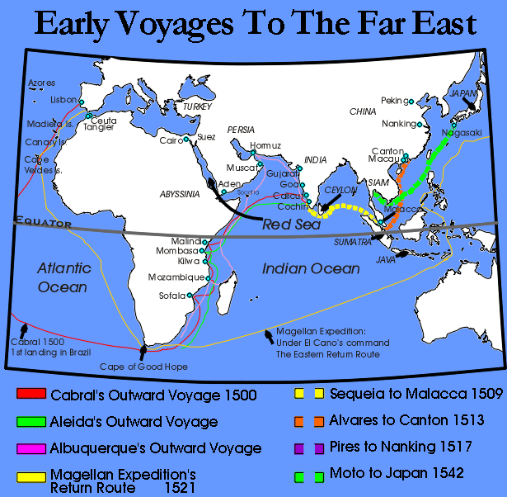
Howitt on “Hero” Alphonso Albuquerque:
He “seized on Goa, which thenceforward became the metropolis of all the Portuguese settlements in India. He… gave [Molucca] up to the plunder of his soldiers… with a fifth part of the wealth… reserved for the king… proceeded to Ormuz… reduced it, placed a garrison in it, seized on fifteen princes of the blood…; made a descent on the isle of Ceylon. With less than 40,000 troops, the Portuguese struck terror into the empire of Morocco, the barbarous nations of Africa [the Swahili East Cost], the Mamelucs, the Arabians, and all the eastern countries from the island of Ormuz to China.”

Slide 32
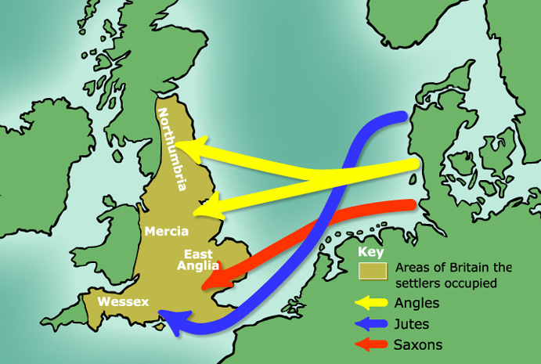
Predatory “Exploration” – Even Then Not New
Eminent historian Bloch describes the terror the original inhabitants of the British islands lived under from the men of the north, the “Norsemen,” or the Vikings:

Slide 33
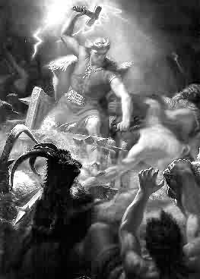
People moved from the coasts and lowlands to hide in fortress strongholds in England, fearing sudden attack by Angles and Saxons.

Slide 34
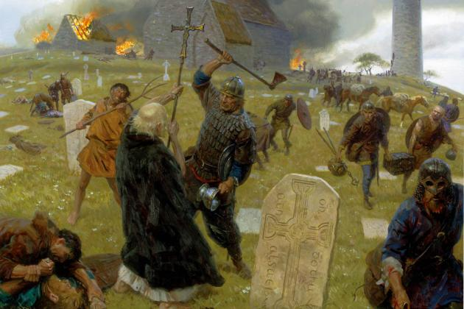

Slide 35
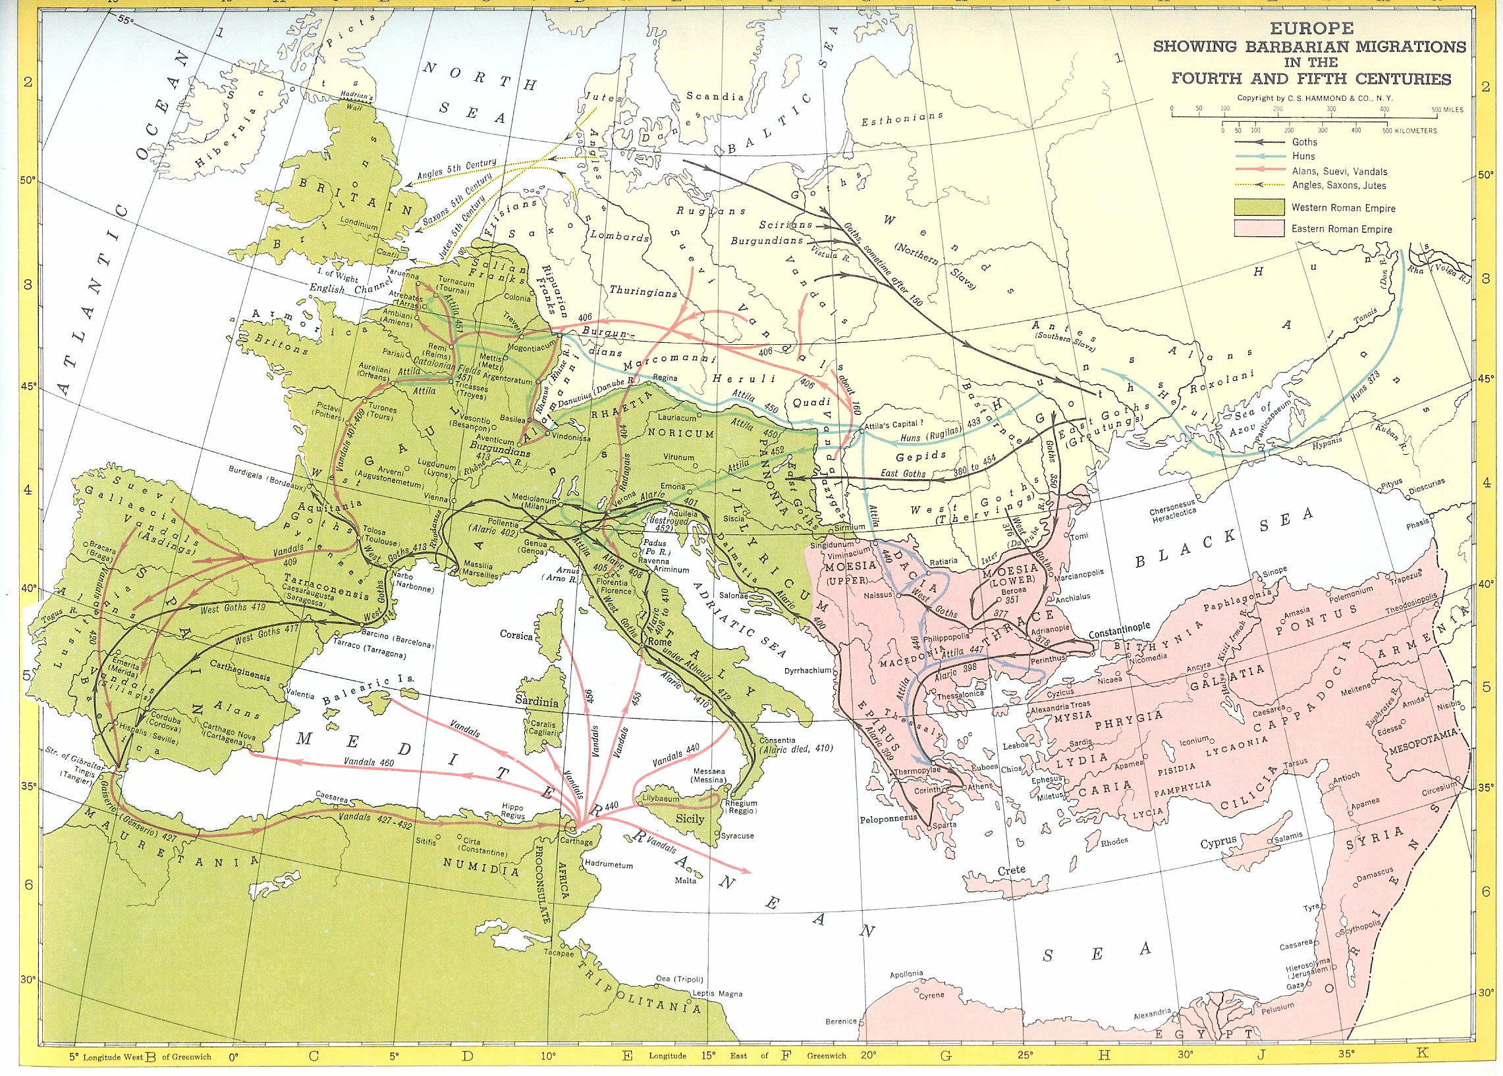
Notes:
Europe showing barbarian migrations in the 4th and 5th centuries.

Slide 36
“Shock and Awe” Planned for Iraq
”CBS news reported last weekend that the invasion [of Iraq] will begin with war planes and ships launching between 300 and 400 cruise missiles on day one… more than the number of missiles launched during the whole of “Desert Storm” in 1991. At an average rate of one weapon every four minutes around the clock, missiles will relentlessly rain down on Baghdad and knock out water supplies, electricity services, communications, government buildings, roads, bridges and other essential infrastructure… Tens of thousands of Iraqis, civilians as well as soldiers, were slaughtered during the brief 1991 war.
This time, Pentagon officials have declared, the saturation bombing will exceed anything previously seen in history. “The sheer size of this has never been seen before, never been contemplated before,” a Pentagon official told CBS. “There will not be a safe place in Baghdad.” This co-called “Rapid Dominance” battle plan is based [on] a concept formulated in a report drawn up by the Pentagon-run National Defense University in 1996—that is, under the Clinton administration and well before events of September 11, 2001. The concept is dubbed “Shock and Awe” because it seeks the psychological overwhelming of the enemy, and, by extension, the intimidation of the world’s population

Slide 37
Rapid Dominance, or Shock and Awe theorized…
. Speaking to CBS news, one of the report’s authors, Harlan Ullman, drew a direct parallel to Hiroshima. Within two to five days, the Iraqi people would be “physically, emotionally and psychologically exhausted,” he stated. He spoke of having “this simultaneous effect, rather like the nuclear weapons at Hiroshima, not taking days or weeks but in minutes.”
This theme is elaborated in the 1996 report: “The key objective of Rapid Dominance is to impose [an] overwhelming level of Shock and Awe against an adversary on an immediate or sufficiently timely basis to paralyze its will to carry on. In crude terms, Rapid Dominance would seize control of the environment and paralyze or so overload an adversary’s perceptions and understanding of events that the enemy would be incapable of resistance at tactical and strategic levels. An adversary would be rendered totally impotent and vulnerable to our actions…”

Slide 38
DuBois:
“There was no Nazi atrocity—concentration camps, wholesale maiming and murder, defilement of women or ghastly blasphemy of childhood—which the Christian civilization of Europe ha not long been practicing against colored folk in all parts of the world in the name of and for the defense of a Superior Race born to rule the world.” p. 23

Slide 39
Chapter 3: The Rape of Africa
“Nothing which has happened to man in modern times has been more significant than the buying and selling of human beings out of Africa into America from 1441 to 1870. Of it worldwide meaning and effect, this chapter seeks to tell.”

Slide 40
Infusion of the black world into global settings, in particular:
Spain and Portugual, Italy and Europe.47
Mohammedan (Arab) invasions.48
Brief history of the slave trade. The British.50
Gold and silver as value versus labor as value creating.

Slide 41
Karl Marx – his unanswerable charge:
p. 56.

Slide 42
The revolt against slavery by black people as major early revolt against labor exploitation.60

Slide 43
The ideological struggle against slavery and exploitation, and Oppression:
The U.S. “Revolutionary War”62
The French Revolution.63

Slide 44
Capitalism and Slavery
The economics of capitalism lead to end of the slave trade and end of slavery social system.65
1807

Slide 45
The Arab Slave Trade and Ivory
A new means of control.
The size of the Ivory Trade: 514 tones a year.75
The ivory trade in South Africa by the Dutch, and eventually Selous and Lord Lugard slaughter herds of half-human elephants… 70
Hamed bin Muhammed, Tippoo Tib, “great” slave trader.72
Suppression by Livingston for colonial ownership for England and Europe.73
Decisions made for profit and not human outcomes yield contradictory outcomes.74.

Slide 46
Result? Larger and Deeper Social Disintegration
The total disruption of society under horrible circumstances.76

Slide 47
In the twilight of DuBois’ long life of struggle, he made two monumental decisions:
To immigrate to Africa, Ghana in particular.
To become a member of the Communist Party.
NEITHER ONE SHOULD BE MINIMIZED
The place for an African to be in the worldwide struggle over resources and lifestyles is Africa; and the system to be destroyed and replaced is capitalism.

Slide 48
The Critical Mistake
IT IS A CRITICAL MISTAKE TO UNDERRATE POINTS #1 AND #2 BECAUSE THE WORD “BLACK” OR “AFRICAN (AMERICAN)” DOES NOT APPEAR.
THESE ARE THE ESSENTIAL FEATURES UPON WHICH THE POWER TO DEFINE BLACK PEOPLE RESTS. WITHOUT THEM THERE WOULD BE NO #3. OUR TASK IS TO DEFEAT A SYSTEM, AND CHANGING IDEAS ABOUT THE SYSTEM IS 50% OF THE EFFECTIVE STEPS TO BE TAKEN.

Slide 49
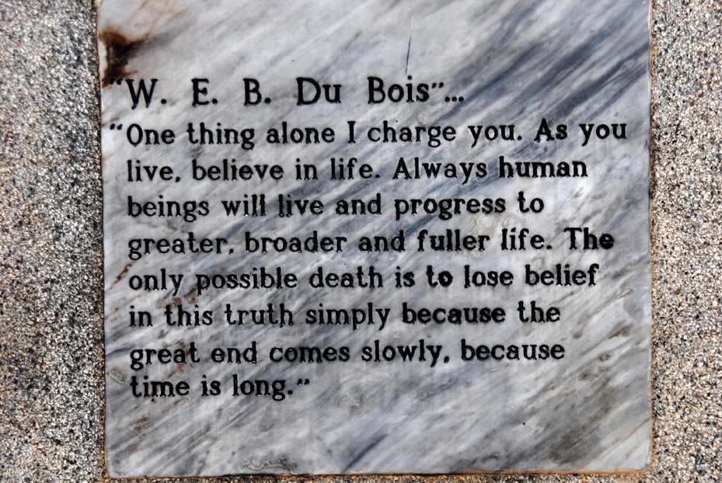
Plaque at the W.E.B. DuBois House in Accra, GHANA

